Slide 1
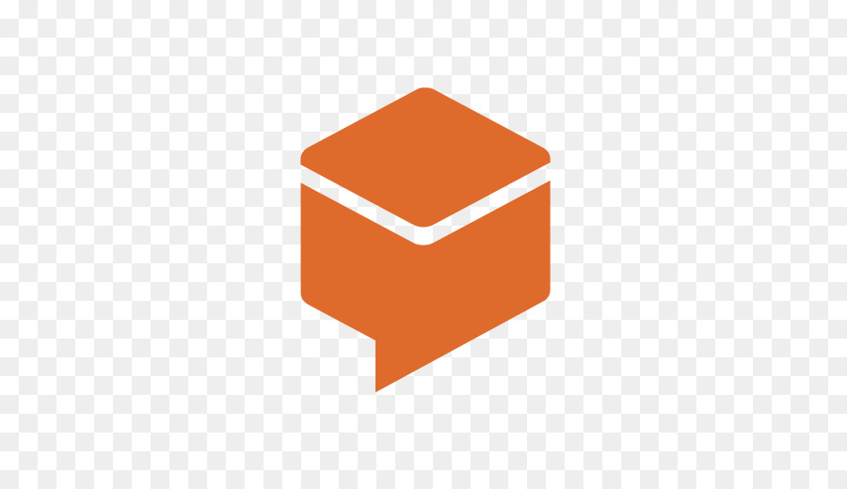

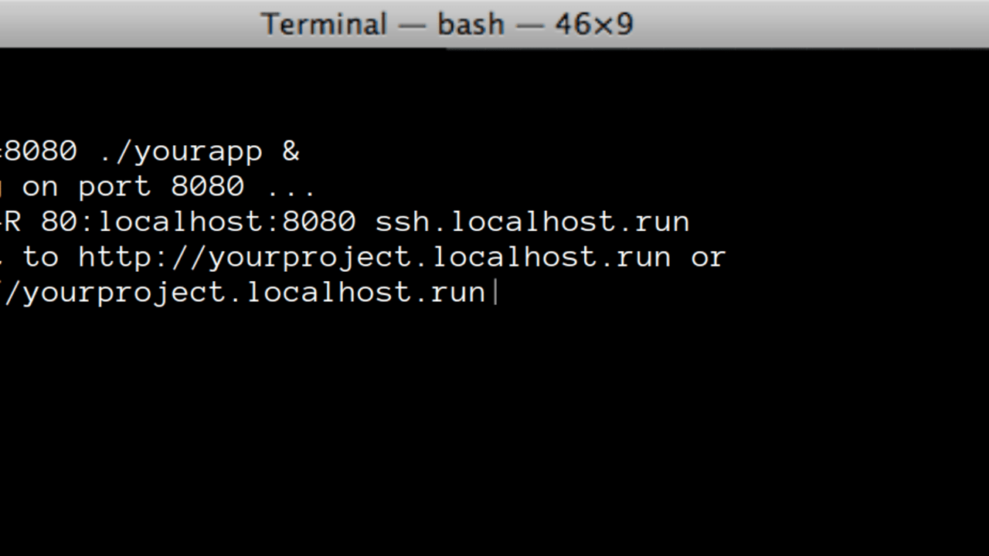
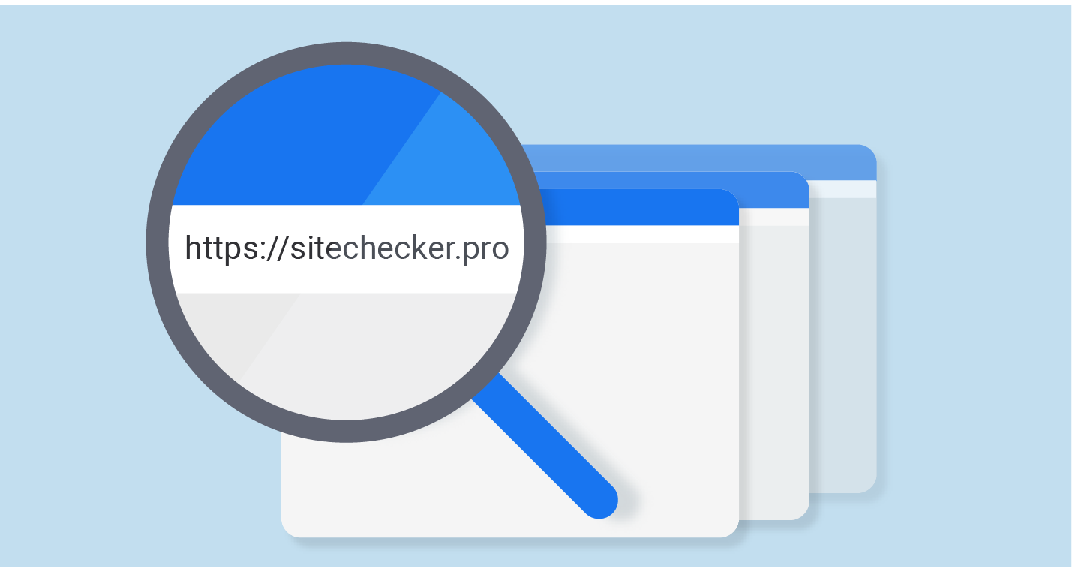
Generates the backend conditional responses that are then displayed in Dialogflow(webhook)
Chatbot
Flask web framework
Google Dialogflow
Written in Python
User Interface/Frontend
Backend
Chatbot displayed on website using third party customer support software called Kommunicate
Ngrok
Health Website
Allows you to use the backend flask code with the frontend Dialogflow
Written in HTML/CSS

